Slide 1
2013 Roadway Rejuvenation Program

Slide 2
Historic Roadway Maintenance and Paving Program
Pascack Valley Cooperative Road Improvement Program
2008 - $ 350,000
2009 - $ 325,000
2010 - $ 130,000
2011 - $ 768,000
2012 - $ 510,000
2012 Improvements to 1.8 miles of roadway
4.5% of Borough roads

Slide 3
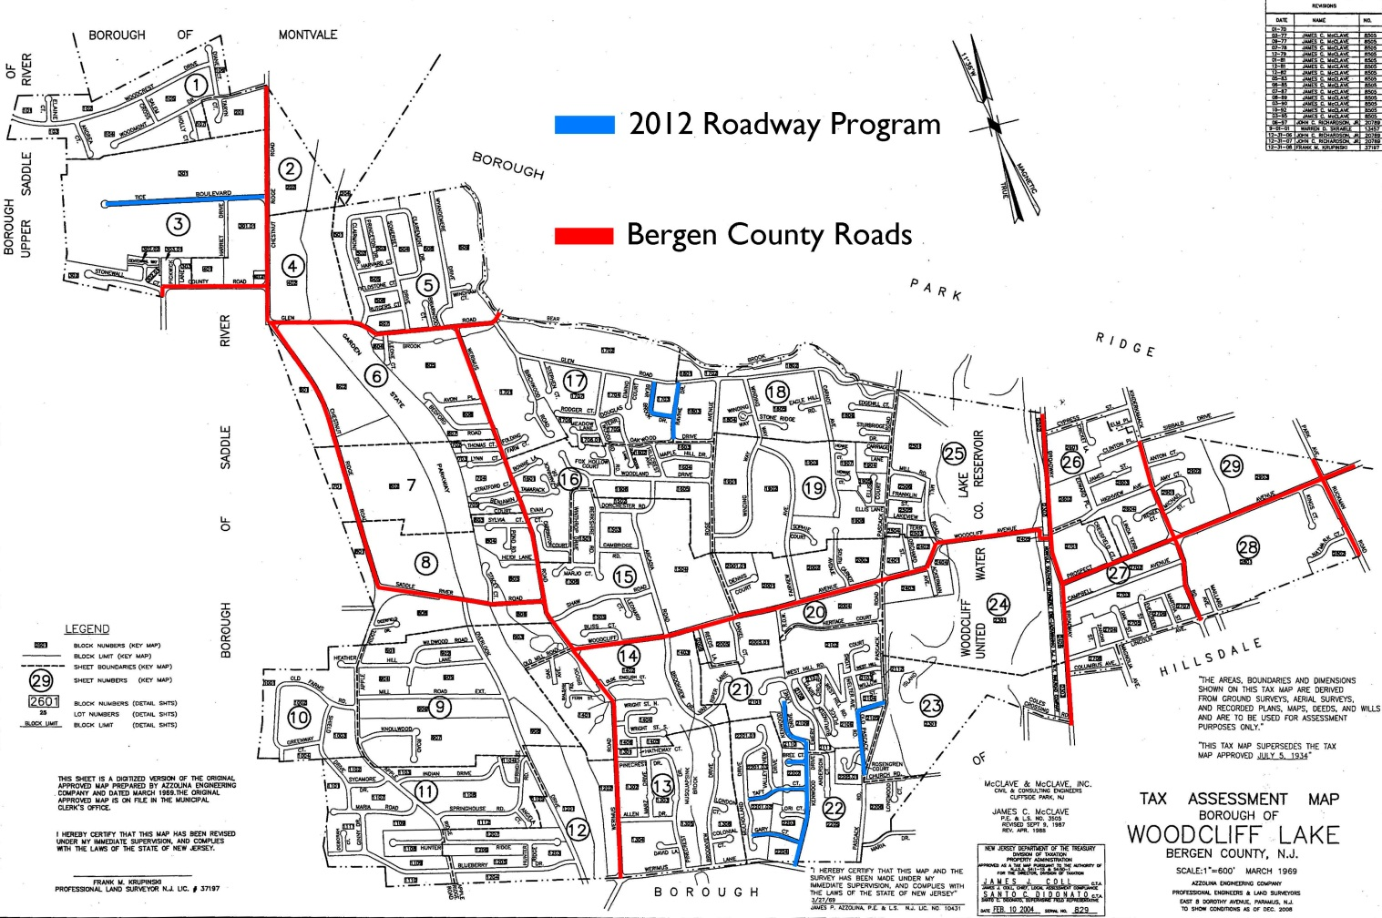
Historic Roadway Maintenance and Paving Program
2012 Roadway Program = 1.8 miles

Slide 4
Borough Vision
The intelligent and proactive management of infrastructure
Borough will undertake a road assessment initiative to determine priority ranking of roads to be addressed on an annual basis
To maintain an elevated quality of life and appreciated home value for the residents of Woodcliff Lake

Slide 5
2013 Roadway Program
Coordinated Road Assessment with DPW
Condition, use, and age
16 roads were identified for rehabilitation
Majority were last paved between 15-20 years ago
Milling & paving, minimal curb restoration, and inlet improvements
Improvements to 3.3 miles of roadway
2013 Impact = 8.25% of Borough roads

Slide 6
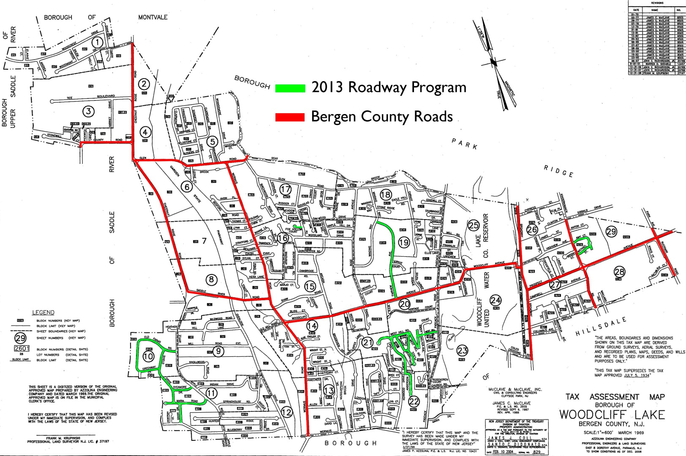
2013 Roadway Program
2013 Roadway Program = 3.3 miles

Slide 7
Pascack Valley Cooperative Road Improvement Program
The Borough was 1 of 8 participating municipalities in the 2012 Road Improvement Program
$72.85 per ton asphalt price under joint bid by participating municipalities
Non-participating municipalities saw increased asphalt prices;
$74.50, $83.80, and $90.30 per ton

Slide 8
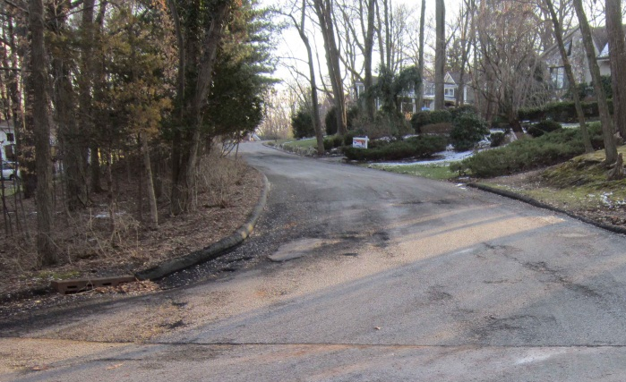
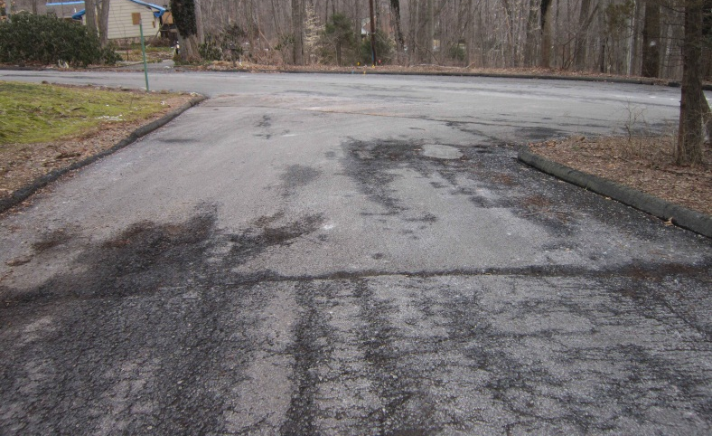
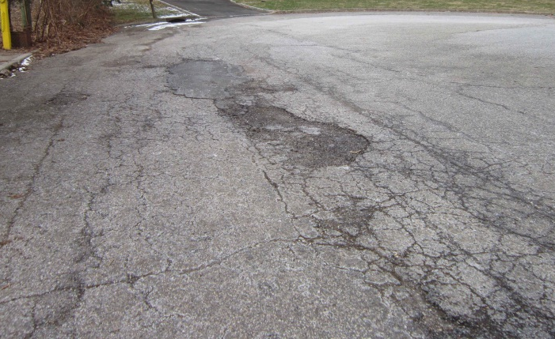
Existing Roadway Conditions
West Hill Road
West Hill Road
Claire Circle
Fairview Avenue

Slide 9
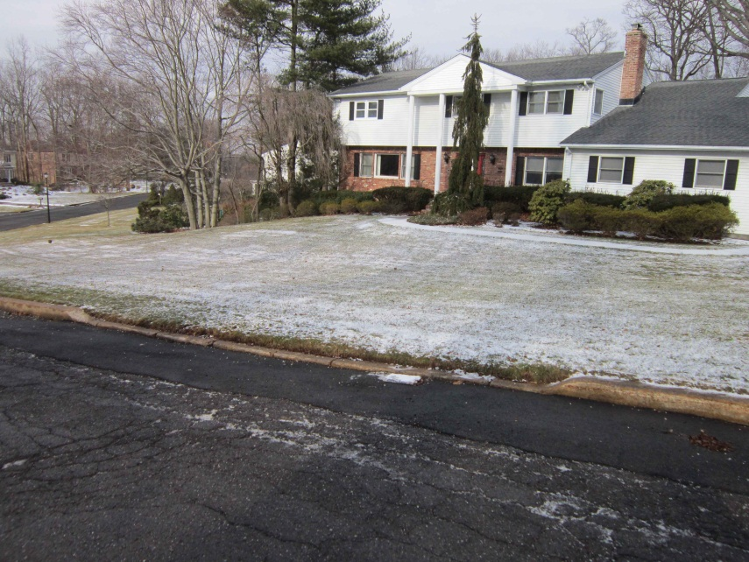
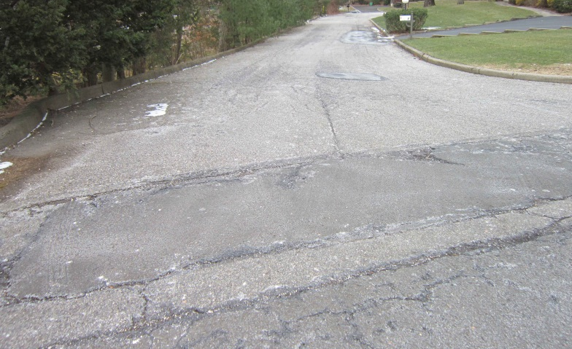
Existing Roadway Conditions
Maria Road
Fox Hollow Court
Shield Drive
Fairview Avenue

Slide 10
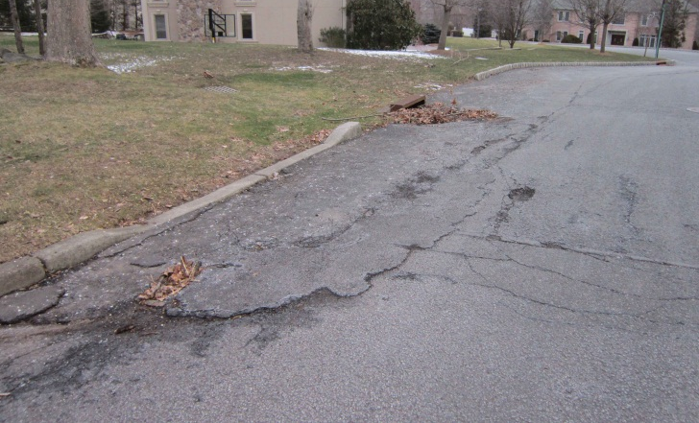
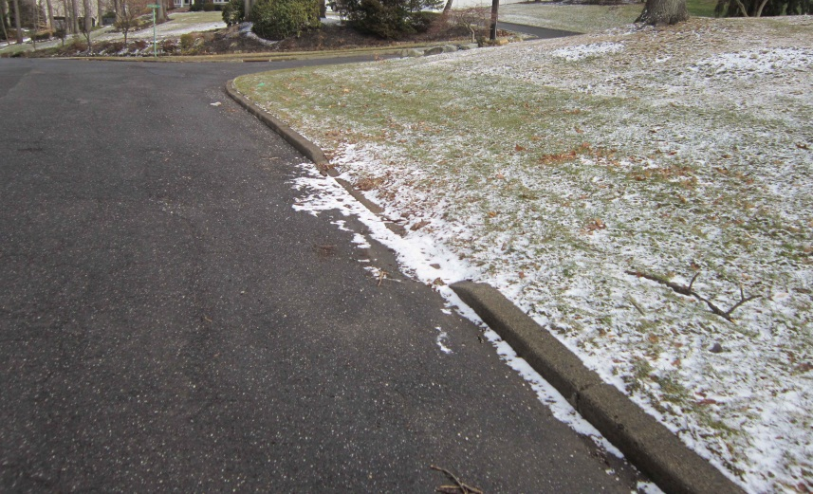
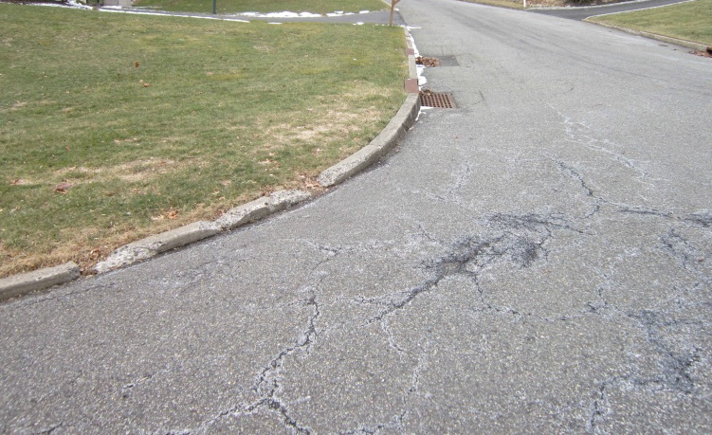
Existing Curb Conditions
Maria Road
Emery Lane
Shield Drive
Amy Ct & Michael St

Slide 11
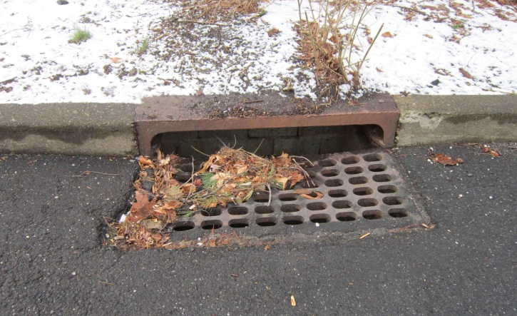
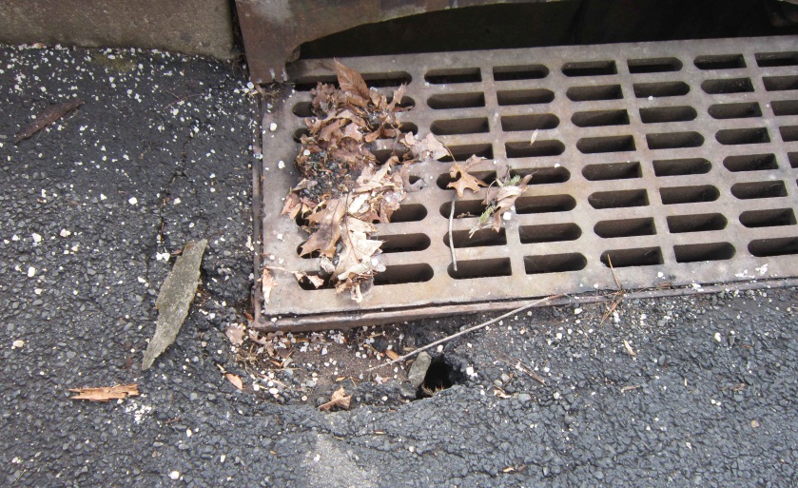
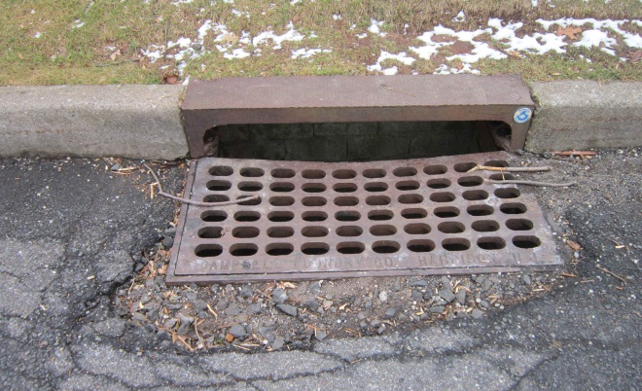
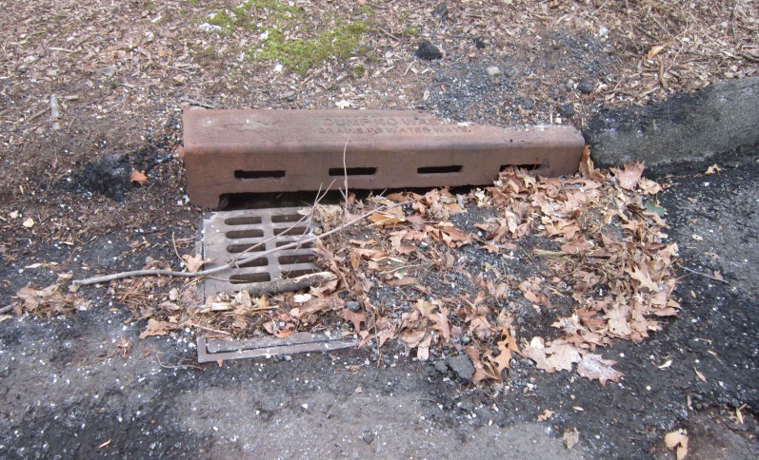
Existing Inlet Conditions
Shield Drive
Sophie Court
Fairview Avenue
Claire Circle

Slide 12
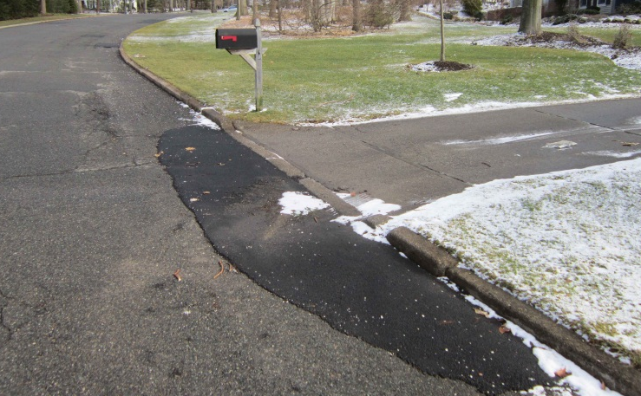
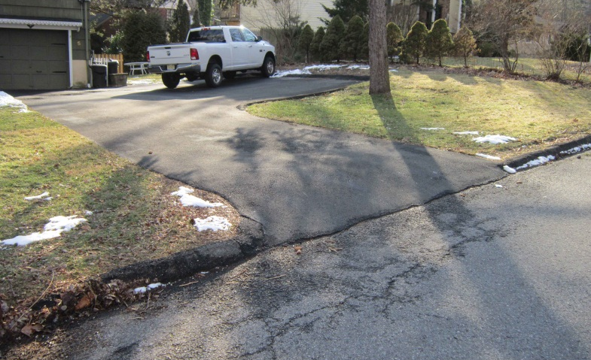
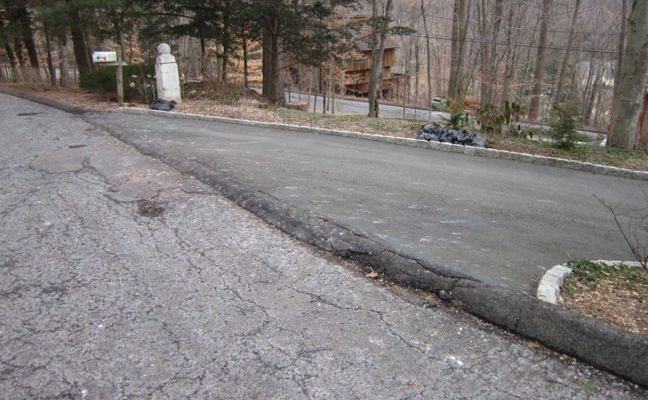
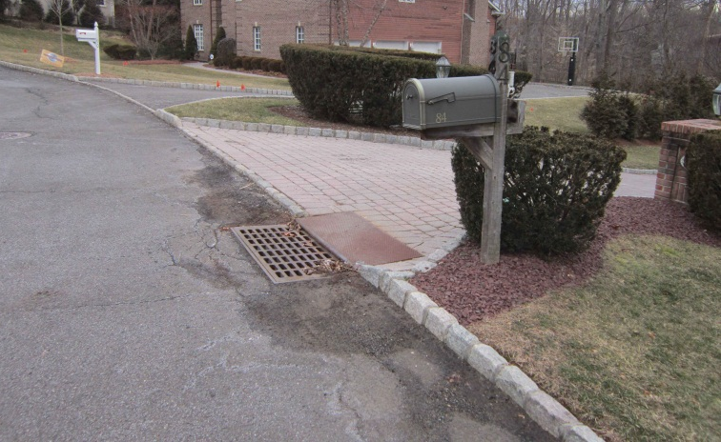
Existing Driveway Conditions
Shield Drive
West Hill Road
Claire Circle
Emery Lane

Slide 13
2013 Roadway Program
The intelligent and proactive management of our infrastructure will result in elevated quality of life and appreciated home values for our residents

